Slide 1
Chapter 7, 9
CSE-214
Presented By:-
MD. IFTEKHARUL ISLAM SAKIB
Lecturer, CSE, BUET

Slide 2
AND, OR AND XOR
Syntax
AND destination, source
OR destination, source
XOR destination, source
The restrictions of destination and source are the same as ADD or SUB instructions

Slide 3
AND, OR AND XOR
Effect on flags
SF, ZF, PF reflect the result
AF is undefined
CF, OF = 0

Slide 4
AND, OR AND XOR
Example
XOR AX, AX
OR CX, CX
CMP CX,0
AND AL, 0Fh
Clearing a Register
Testing a Register for 0
Converting ASCII Digit to a number

Slide 5
NOT Instruction
Works on a single operand
Performs one’s complement operation on the destination
Syntax
NOT destination

Slide 6
TEST Instruction
Performs similarly to the AND instruction
Except doesn’t write the output on the destination.
Only sets or resets the flags
Syntax
TEST destination, source
Usually used for flow control

Slide 7
TEST Instruction
Example
TEST AL,1
JZ ……
Testing a number is even or not

Slide 8
Shift / Rotate Instructions
Has two possible formats:
Opcode destination, 1
Opcode destination, CL
Effect on flags
SF, ZF, PF reflect the result
AF is undefined
CF value changes according to Shift / Rotate Type
OF =1 if result changes sign on last Shift / Rotation

Slide 9
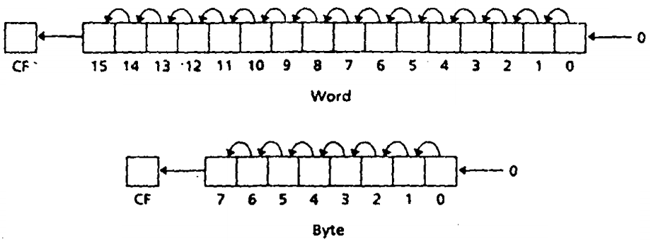
SHL and SAL instructions
Shifts the bits in the destination to the left
The MSB is shifted into CF
A 0 is shifted to LSB
SAL and SHL generate the same machine code
SHL and SAL

Slide 10
SHL and SAL instructions
Example
If DH=8AH, CL=3
What is the result of
SHL DH, CL
If DX=8AH, CX=3
What is the result of
SHL DX, CX
DH=50H
CF=0
OF=0
DX=450H
CF=0
OF=0

Slide 11
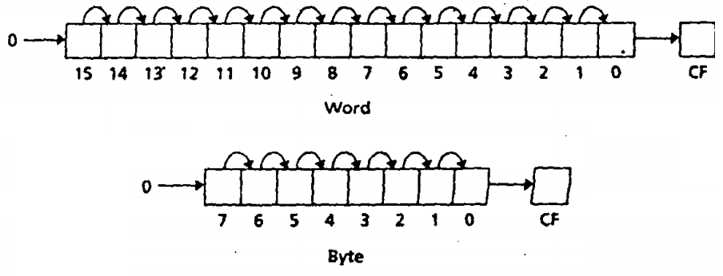
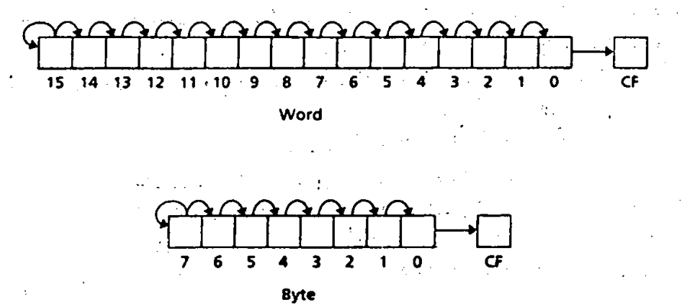
SHR and SAR instructions
Shifts the bits in the destination to the right
The LSB is shifted into CF
In case of SAR MSB retains its original value
SHR
SAR

Slide 12
SHR and SAR instructions
SHR should be used for unsigned interpretation as it does not preserve sign
SAR should be used for signed interpretation as it preserves sign

Slide 13
SHR and SAR instructions
Example
If AL=-15, CL=1
What is the result of
SHR AL, CL
If AL=-15, CL=1
What is the result of
SAR AL, CL
AL=120
CF=1
OF=1
AL=-8
CF=1
OF=0

Slide 14
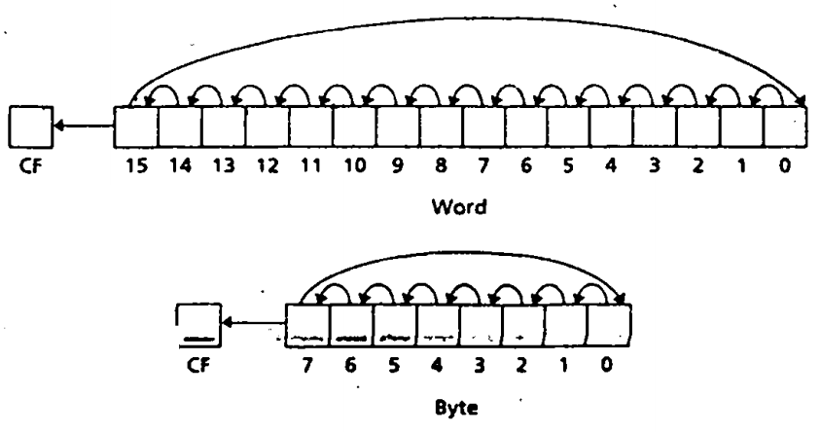
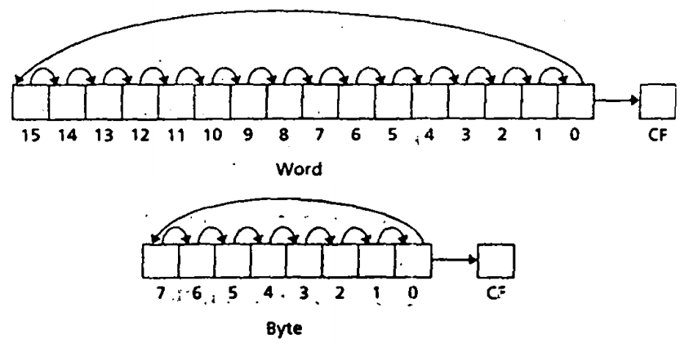
ROL and ROR
ROL and ROR shifts bits in destination to the left and right respectively
For ROL MSB is shifted into the rightmost bit and CF
FOR ROR rightmost bit is shifted into MSB and CF
ROL
ROR

Slide 15
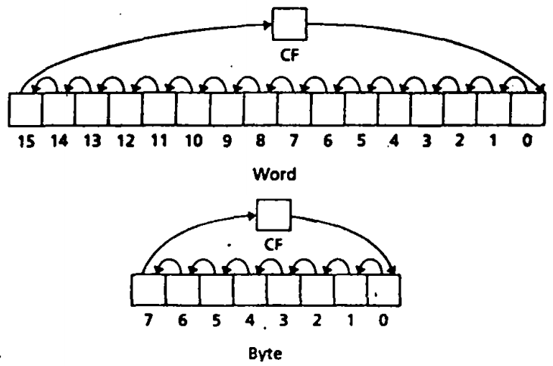
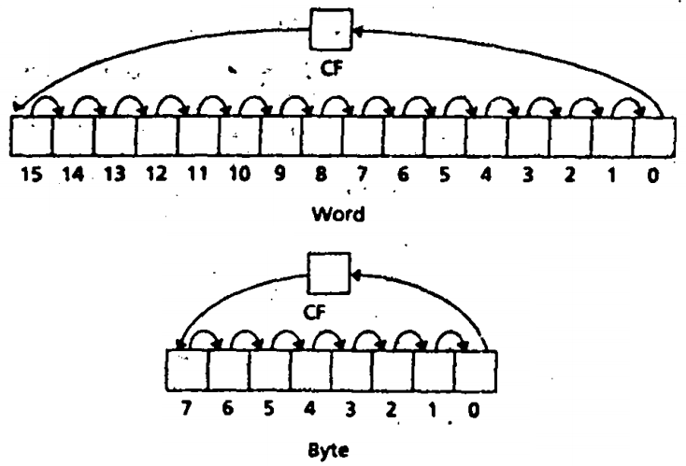
RCL and RCR instructions
Works similarly to ROL and ROR respectively
For RCL, CF is shifted to LSB and MSB is shifted to CF
FOR RCR, CF is shifted to MSB and LSB shifted to CF
RCL
RCR

Slide 16
Multiplication instructions
imul source
Signed multiply
mul source
Unsigned multiply
Byte and Word Multiplication (A X B)
If two bytes are multiplied, the result is a 16-bit word
A: source
B: al
product: ax
If two words are multiplied, the result is a 32-bit doubleword
A: source
B: ax
Product (ms 16 bits): dx
Product (ls 16 bits): ax

Slide 17
Multiplication instructions
source can be a register or memory location (not a constant)
Byte form
AX=AL*source
Word form
DX:AX=AX*source
If ax contains 0001h and bx contains FFFFh
mul bx; dx = 0000h ax = FFFFh
imul bx ; dx = FFFFh ax = FFFFh (-1)

Slide 18
Multiplication instructions
Effect on flags
SF, ZF, AF, and PF Undefined
CF/OF
MUL
0: if upper half result 0
1: Otherwise
IMUL
0: if upper half is sign extension of lower half.
1: Otherwise

Slide 19
More Examples
AX=FFFFh,BX=FFFFh
Instruction | Hex Product | DX | AX | CF/OF
MUL BX | FFFE0001 (4294836225) | FFFE (!zero) | 0001 | 1
IMUL BX | 1 | 0000 | 0001 | 0
AL=80h,BL=FFh
Instruction | Hex Product | AH | AL | CF/OF
MUL BL | 7F80 (128) | 7F(!zero) | 80 | 1
IMUL BL | 0080 | 00 (no sign extension) | 80 | 1

Slide 20
Division instructions
cbw
convert byte to word
cwd
convert word to doubleword
div source
unsigned divide
idiv source
signed divide

Slide 21
Byte and Word Division (A/B)
When division is performed
two results: the quotient and the remainder
Quotient and remainder are same size as the divisor
For the byte form,
Divisor, B: source ;Dividend , A: ax
Quotient :al ;Remainder: ah
For the word form,
Divisor, B: source ;Dividend , A: dx:ax
Quotient :ax ; Remainder: dx

Slide 22
An Example
;If dx = 0000h, ax = 0005h, and bx = FFFEh (-2)
div bx; ax = 0000h dx = 0005h
idiv bx; ax = FFFEh dx = 0001h

Slide 23
Divide Overflow
It is possible that the quotient will be too big to fit in the specified destination (al or ax)
if the divisor is much smaller than the dividend
the program terminates and the system displays the message "Divide Overflow"

Slide 24
Sign Extension of the Dividend
Word division
The dividend is in dx:ax even if the actual dividend will fit in ax
For div, dx should be cleared
For idiv, dx should be made the sign extension of ax using cwd
e.g. -1250/7
MOV AX,-1250
CWD ; sign extend
MOV BX,7
IDIV BX

Slide 25
Sign Extension of the Dividend
Byte division
The dividend is in ax even if the actual dividend will fit in al
For div, ah should be cleared
For idiv, ah should be made the sign extension of al using cbw

Slide 26
Thank you

